Slide 1
Picking

Slide 2
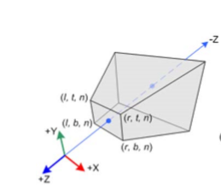
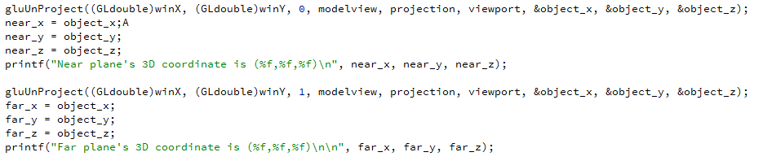
1. Caculate the near and far plane’s point (use gluUnProject())

Slide 3
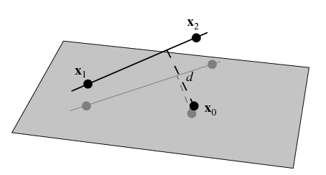
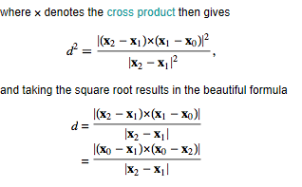
2. Construct a function that can detect if there is an intersection between sphere center and 3D line
http://mathworld.wolfram.com/Point-LineDistance3-Dimensional.html

Slide 4
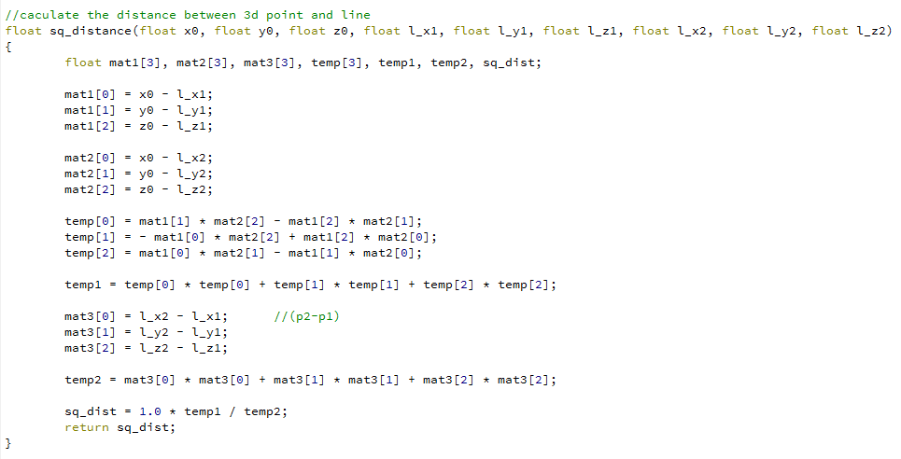

Slide 5
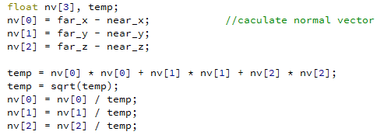
3. Caculate the normal vector from mouse click direction

Slide 6

4. Caculate the distance between camera’s position and sphere’s position

Slide 7
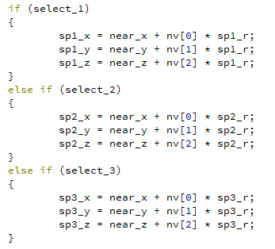
5. When move mouse, change the picking normal vector and implement to sphere’s transformation

Slide 8
Attention
mouse_move_callback()
{
…
glutPostRedisplay();
}

